Slide 1

World Population Analysis using Machine Learning
This presentation explores how machine learning can uncover insights and forecasts about global population trends to guide policy and planning.
By Kunjan Parate

Slide 2
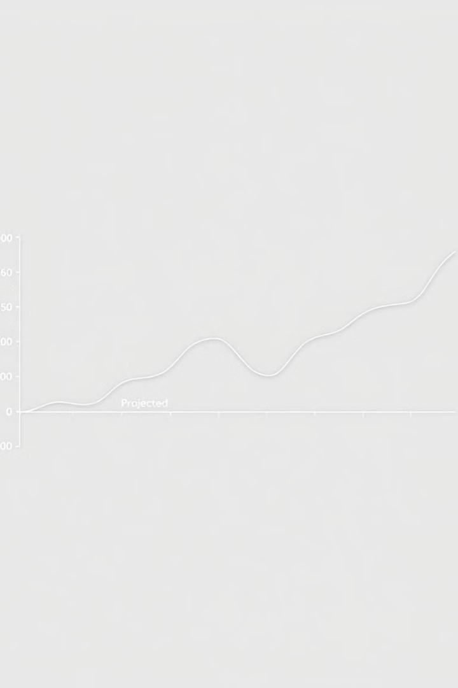
Introduction
Analyze historical population trends
Predict future population growth
Support healthcare, education, and infrastructure planning

Slide 3
Dataset Overview
Data sources
Features
Dataset size
UN, World Bank
population
234 rows, 17 columns
area
density
growth rate
continent
capital

Slide 4
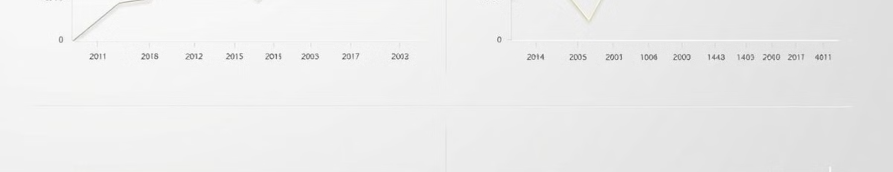
Data Preprocessing and Feature Engineering
Removed unnecessary columns
Created growth rate feature
No missing values found
The dataset was clean and complete, requiring minimal data cleaning.
Streamlined the dataset to focus on the most relevant features.
Calculated a new feature to model population growth trends over time.

Slide 5
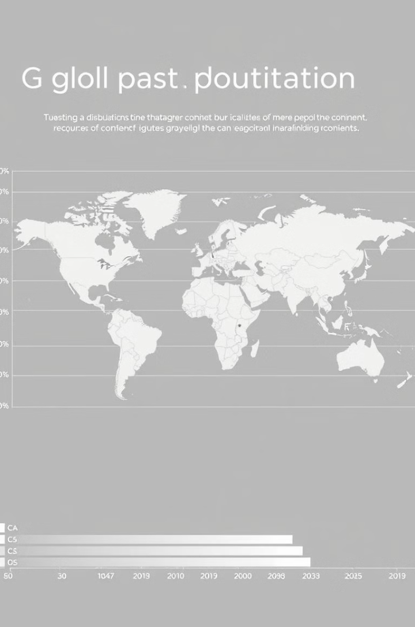
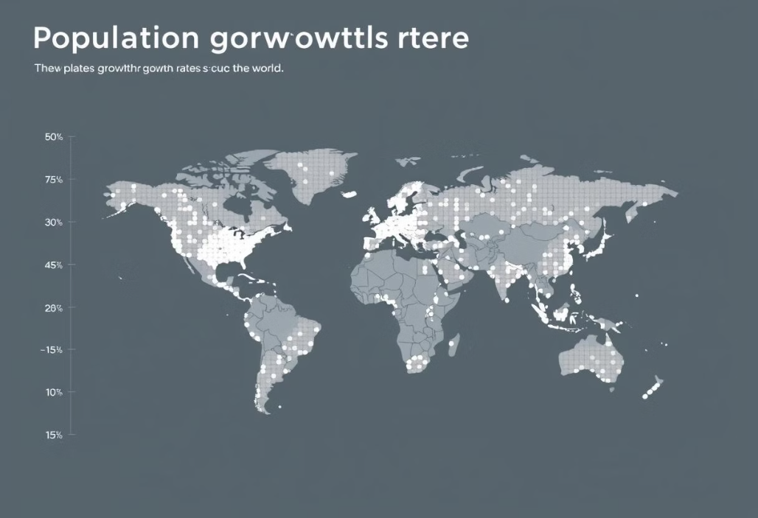
Insights from Population Analysis
Asia dominates with 59.2% of global population
Africa's rapid growth expected to double by 2050

Slide 6
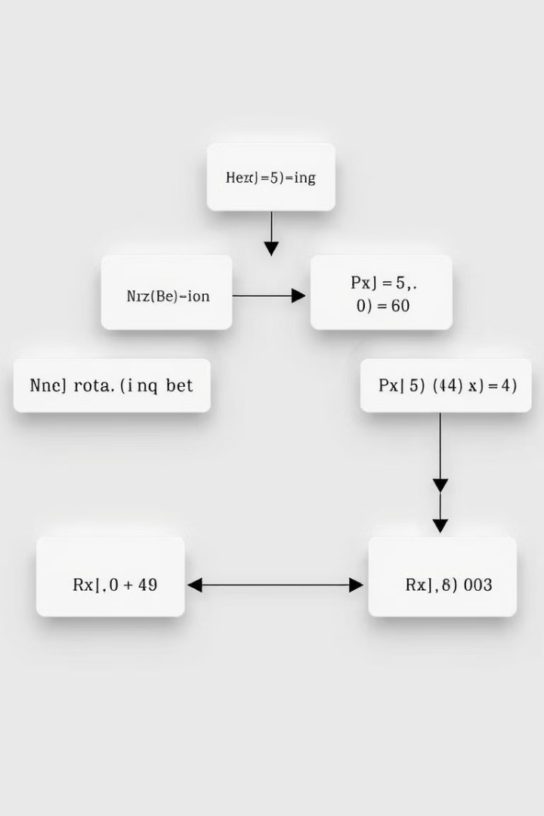
Model Building
Linear Regression model
70/30 train-test split
StandardScaler for feature scaling

Slide 7
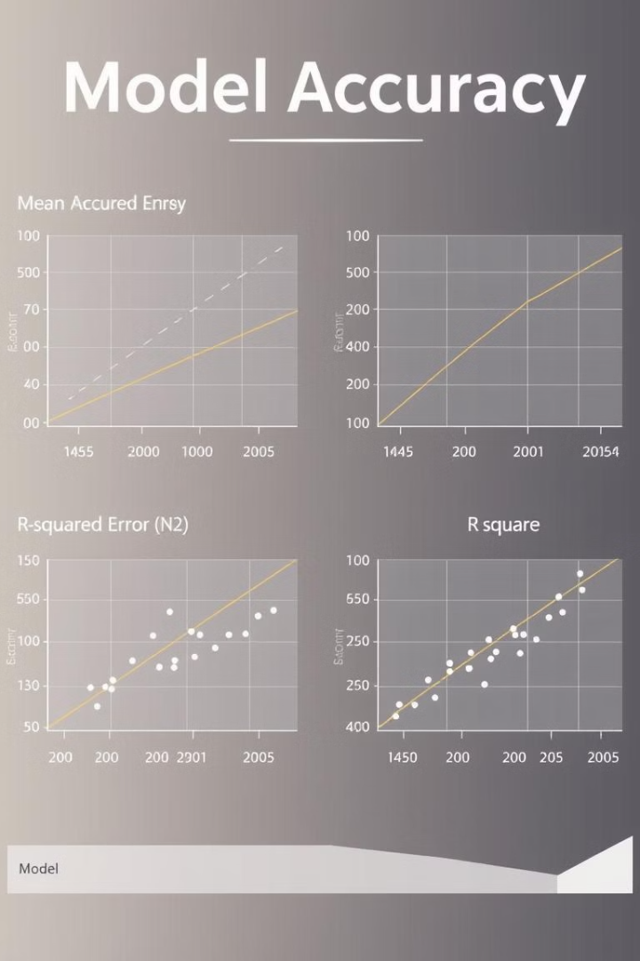
0.7
10.5
R²
MSE
High R² score indicates strong predictive power

Slide 8
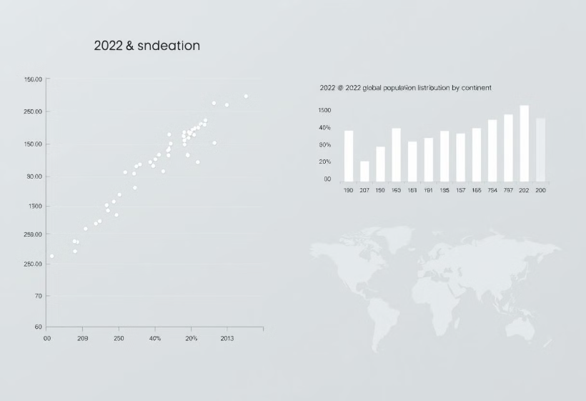
Putting Model to the Test
Scatter plot: Predicted vs. actual 2022 population
Bar chart: 2022 population by continent
Visuals validate model accuracy and key insights

Slide 9
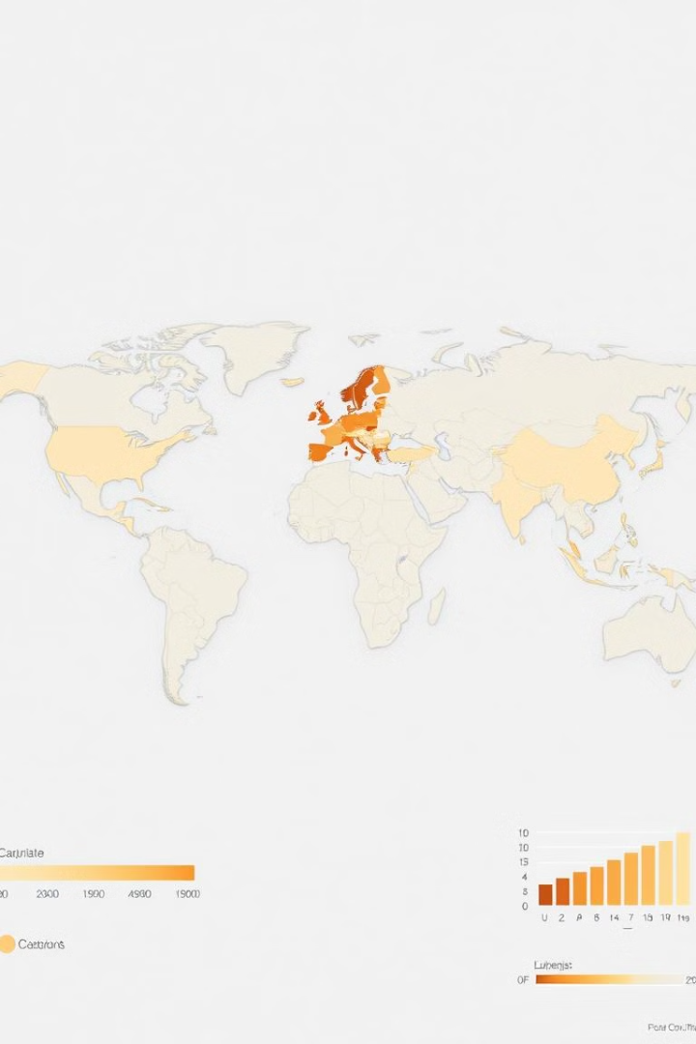
Conclusions and Looking Ahead
Asia's dominance, Africa's rapid growth
Model limitations: explore advanced algorithms
The analysis has shown that Asia dominates with 59.2% of the global population, while Africa's rapid growth is expected to double by 2050.
While the current linear regression model has demonstrated strong predictive power, there may be opportunities to explore more advanced machine learning algorithms to further improve the accuracy of population forecasts.

Slide 10




Future Opportunities
Advanced algorithms
Random Forest
XGBoost
Additional factors
fertility
migration
urbanization
Country-level forecasts

